Slide 1
States of Consciousness
Chapter 5

Slide 2
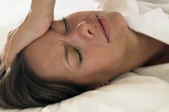
States of Consciousness
Consciousness
  Sensations and perceptions
    External events
  Self awareness of
    Thoughts
    Feelings
    Memories

Slide 3
States of Consciousness
Waking state of consciousness
  Clear, organized alertness
  Perceive time, places, and events as real, meaningful, and familiar
Altered state of consciousness
  Distinct shifts in the quality and pattern of mental activity
  Sleep, dreaming, and daydreaming
  Emotions, memories, time sense, thoughts, feelings of self control, and suggestibility
    Caused by fatigue, delirium, hypnosis, drugs, and euphoria

Slide 4
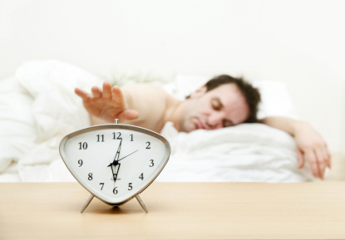
States of Consciousness
T or F: Sleep is a state of consciousness?
Sleep disturbances (Table 5.1, p. 174) – Which ones have you experienced?
  7 behavioral remedies (p. 175-176)
Sleep deprivation
  Brain changes (http://youtu.be/f5E4isZdx8k)
    Motor skills
    Mood
    Concentration

Slide 5
States of Consciousness
Psychodynamic Dream Theory
  Internal conflicts, motives, and unconscious forces
  Page 178
  Client session
    Wish fulfillment
    Dream symbols
    Manifest content
    Latent content

Slide 6


States of Consciousness
Hypnosis
  Narrowed attention and increased suggestibility
Meditation
  Relaxation or heightened awareness

Slide 7
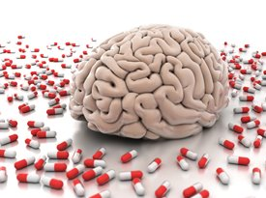
States of Consciousness
Psychoactive Drugs
  Alter attention, judgment, memory, time sense, self-control, emotion, and perception
  Figure 5.10 (p. 185)
  Based on the spectrum and continuation of drug action, what one thing do stimulant and depressant drug effects and drug groups have in common?
http://youtu.be/zXjANz9r5F0

Slide 8
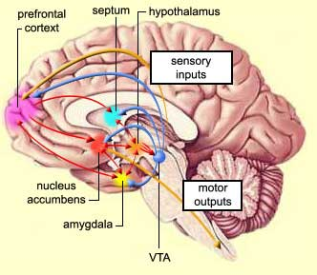
States of Consciousness
Hypothalamus
  Temperature
  Hunger
  Thirst
  Sleep
  Fatigue
Nucleus accumbens
  Reward
  Pleasure
  Aggression
  Fear
  Laughter
Ventral tegmental area (VTA)
  Dopamine origination
  Cognition
  Emotion
  Motivation

Slide 9

States of Consciousness
Marijuana
  The Wood Spider
  Develop a UVU “marijuana myth busting” campaign using the 8 long-term health risks (page 197)

